Slide 1

DIGICROME ACADEMY
NEXT HIKES
2023-24

Slide 2

PROJECT – 07
NLP PROJECT FOR DISASTER TWEET CLASSIFICATION
ANKUR KUMAR GIRI
2023-24

Slide 3
PROBLEM STATEMENT
THE CHALLENGE IS TO BUILD A MACHINE LEARNING MODEL CAPABLE OF ACCURATELY CLASSIFYING TWEETS AS EITHER RELATED TO REAL DISASTERS OR NOT. WHILE SOME TWEETS MAY CONTAIN EXPLICIT KEYWORDS LIKE "FIRE" OR "FLOOD," OTHERS MAY USE SUCH TERMS METAPHORICALLY OR IN A NON-DISASTER CONTEXT. THUS, THE MODEL NEEDS TO DISCERN THE TRUE INTENT BEHIND THE LANGUAGE USED IN TWEETS, WHICH CAN BE NUANCED AND CONTEXT-DEPENDENT.

Slide 4
SITUATIONAL OVERVIEW (DISASTER TWEET)
CLASSIFICATION MODEL DEVELOPMENT: DEVELOP A MACHINE LEARNING MODEL THAT CAN PREDICT WHETHER A TWEET IS ABOUT A REAL DISASTER OR NOT. ACCURACY AND PRECISION: AIM FOR HIGH ACCURACY AND PRECISION IN CLASSIFICATION TO MINIMIZE FALSE ALARMS AND ENSURE TIMELY AND ACCURATE DISASTER DETECTION. ROBUSTNESS: CREATE A MODEL THAT CAN HANDLE VARIATIONS IN LANGUAGE, INCLUDING SLANG, ABBREVIATIONS, AND CULTURAL NUANCES, TO ENSURE EFFECTIVENESS ACROSS DIVERSE TWEET DATASETS. SCALABILITY: BUILD A SCALABLE SOLUTION CAPABLE OF PROCESSING LARGE VOLUMES OF TWEETS IN REAL- TIME TO SUPPORT CONTINUOUS MONITORING EFFORTS.

Slide 5
EXPLORATORY DATA ANALYSIS (EDA)
CONTENTS
STEPS IN EXPLORATORY DATA ANALYSIS (EDA)
SOFTWARE REQUIREMENTS
FLOW CHART OF EXPLORATORY DATA ANALYSIS .

Slide 6
EXPLORATORY DATA ANALYSIS
EXPLORATORY DATA ANALYSIS (EDA) IS A CRUCIAL INITIAL STEP IN ANY DATA ANALYSIS PROJECT. IT INVOLVES EXAMINING AND UNDERSTANDING THE CHARACTERISTICS, PATTERNS, AND RELATIONSHIPS PRESENT IN A DATASET. EDA ALLOWS DATA SCIENTISTS AND ANALYSTS TO GAIN INSIGHTS INTO THE DATA, IDENTIFY POTENTIAL PROBLEMS OR ANOMALIES, AND FORMULATE HYPOTHESES FOR FURTHER INVESTIGATION.
UNDERSTAND THE DATA: GET A COMPREHENSIVE UNDERSTANDING OF THE DATASET, INCLUDING ITS STRUCTURE, VARIABLES, AND THEIR TYPES. THIS INVOLVES EXPLORING THE DIMENSIONS OF THE DATASET (NUMBER OF ROWS AND COLUMNS), DATA TYPES (NUMERIC, CATEGORICAL, ETC.), AND ANY MISSING OR NULL VALUES.

Slide 7
STEPS IN EXPLORATORY DATA ANALYSIS (EDA)
EXPLORATORY DATA ANALYSIS (EDA) IS A CRITICAL STEP IN DATA ANALYSIS WHERE YOU EXAMINE AND SUMMARIZE THE MAIN CHARACTERISTICS OF A DATASET, USUALLY THROUGH VISUALIZATION AND DESCRIPTIVE STATISTICS. IT HELPS YOU UNDERSTAND YOUR DATA, FIND PATTERNS, DETECT ANOMALIES, AND FORMULATE HYPOTHESES FOR FURTHER ANALYSIS. EDA INVOLVES TASKS LIKE:
DATA CLEANING: HANDLING MISSING VALUES, DEALING WITH OUTLIERS, AND RESOLVING INCONSISTENCIES IN THE DATA.
DESCRIPTIVE STATISTICS: COMPUTING MEASURES LIKE MEAN, MEDIAN, MODE, STANDARD DEVIATION, ETC., TO UNDERSTAND THE CENTRAL TENDENCY AND DISPERSION OF THE DATA.
VISUALIZATION: CREATING PLOTS SUCH AS HISTOGRAMS, BOX PLOTS, SCATTER PLOTS, AND HEATMAPS TO VISUALIZE THE DISTRIBUTION, RELATIONSHIPS, AND TRENDS IN THE DATA.
FEATURE ENGINEERING: CREATING NEW FEATURES FROM EXISTING ONES OR TRANSFORMING FEATURES TO BETTER REPRESENT THE UNDERLYING PATTERNS IN THE DATA.

Slide 8
STEPS IN EXPLORATORY DATA ANALYSIS (EDA)
EXPLORATORY DATA ANALYSIS (EDA) IS A CRITICAL STEP IN DATA ANALYSIS WHERE YOU EXAMINE AND SUMMARIZE THE MAIN CHARACTERISTICS OF A DATASET, USUALLY THROUGH VISUALIZATION AND DESCRIPTIVE STATISTICS. IT HELPS YOU UNDERSTAND YOUR DATA, FIND PATTERNS, DETECT ANOMALIES, AND FORMULATE HYPOTHESES FOR FURTHER ANALYSIS. EDA INVOLVES TASKS LIKE:
DATA CLEANING: HANDLING MISSING VALUES, DEALING WITH OUTLIERS, AND RESOLVING INCONSISTENCIES IN THE DATA.
DESCRIPTIVE STATISTICS: COMPUTING MEASURES LIKE MEAN, MEDIAN, MODE, STANDARD DEVIATION, ETC., TO UNDERSTAND THE CENTRAL TENDENCY AND DISPERSION OF THE DATA.
VISUALIZATION: CREATING PLOTS SUCH AS HISTOGRAMS, BOX PLOTS, SCATTER PLOTS, AND HEATMAPS TO VISUALIZE THE DISTRIBUTION, RELATIONSHIPS, AND TRENDS IN THE DATA.

Slide 9
STEPS IN EXPLORATORY DATA ANALYSIS (EDA)
MULTIVARIATE ANALYSIS: INVESTIGATE INTERACTIONS BETWEEN THREE OR MORE VARIABLES. THIS CAN INVOLVE TECHNIQUES LIKE CLUSTER ANALYSIS, FACTOR ANALYSIS, OR MULTIDIMENSIONAL SCALING TO IDENTIFY GROUPS OR PATTERNS WITHIN THE DATA.
STATISTICAL TESTING: PERFORM STATISTICAL TESTS TO VALIDATE HYPOTHESES OR ASSESS THE SIGNIFICANCE OF RELATIONSHIPS OBSERVED DURING THE ANALYSIS. THIS CAN INCLUDE T-TESTS, ANOVA, CHI-SQUARE TESTS, AND CORRELATION TESTS, DEPENDING ON THE NATURE OF YOUR DATA AND RESEARCH QUESTIONS
DIMENSIONALITY REDUCTION: TECHNIQUES LIKE PRINCIPAL COMPONENT ANALYSIS (PCA) OR T-DISTRIBUTED STOCHASTIC NEIGHBOR EMBEDDING (T-SNE) TO REDUCE THE NUMBER OF FEATURES AND SIMPLIFY THE DATASET WHILE PRESERVING ITS ESSENTIAL CHARACTERISTICS.
FEATURE ENGINEERING: CREATING NEW FEATURES FROM EXISTING ONES OR TRANSFORMING FEATURES TO BETTER REPRESENT THE UNDERLYING PATTERNS IN THE DATA.

Slide 10
SOFTWARE REQUIREMENTS
GOOGLE DRIVE
COLAB

Slide 11
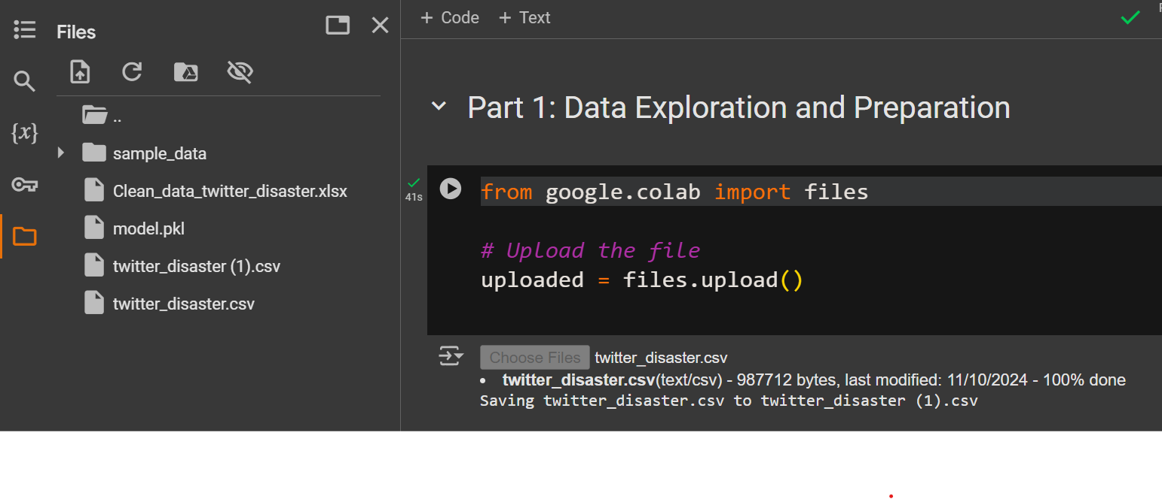
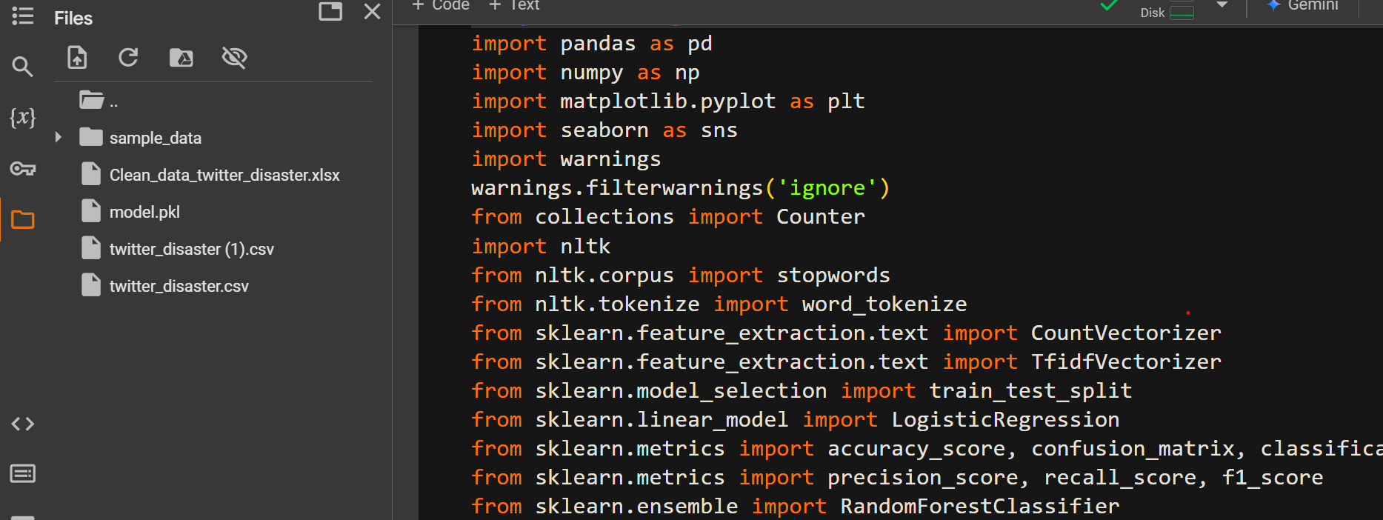

Slide 12
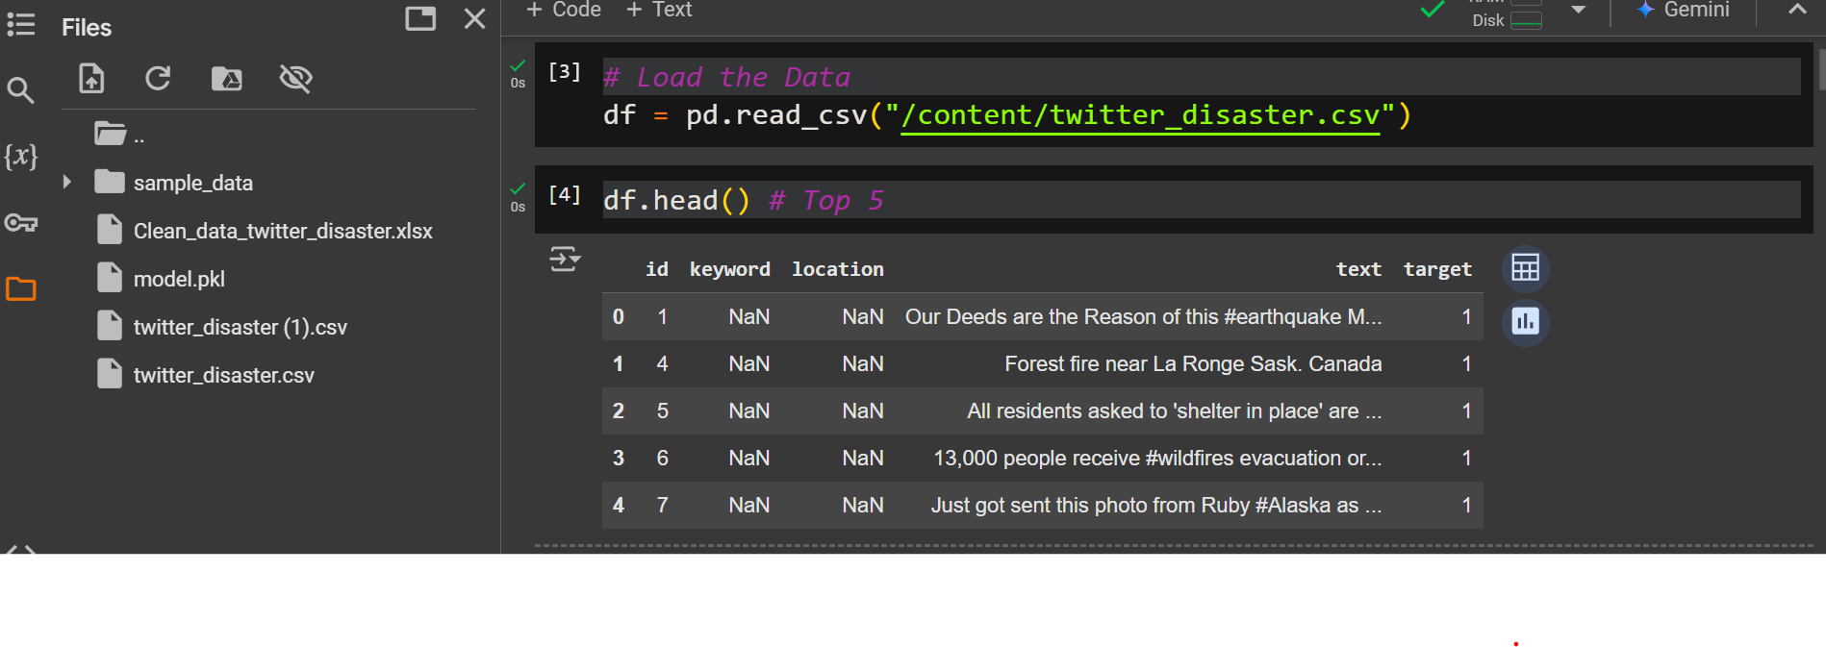
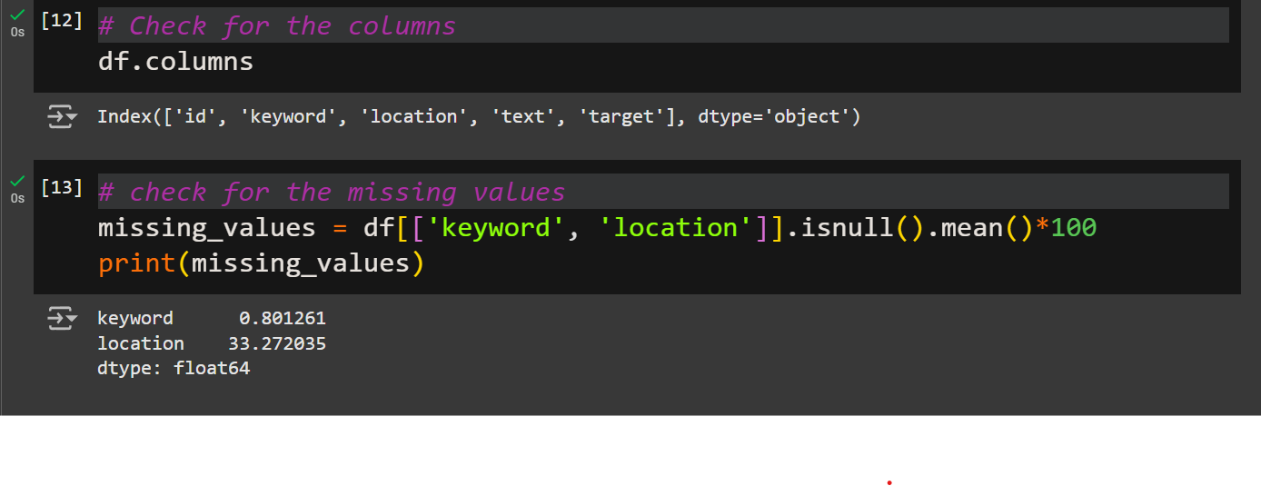

Slide 13
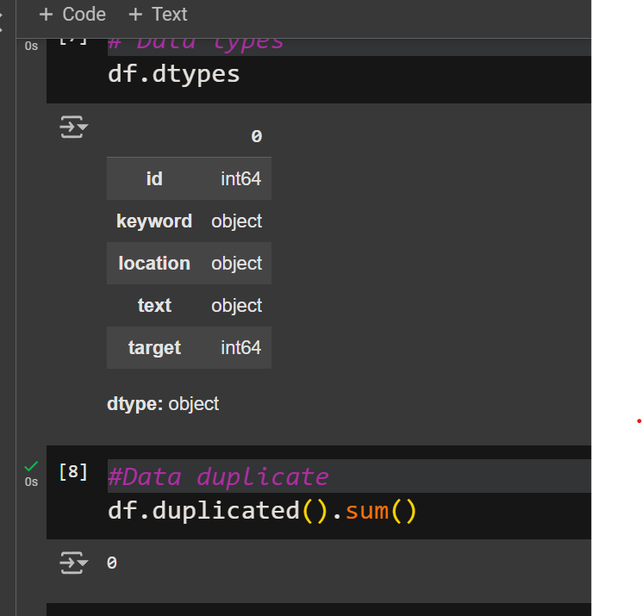
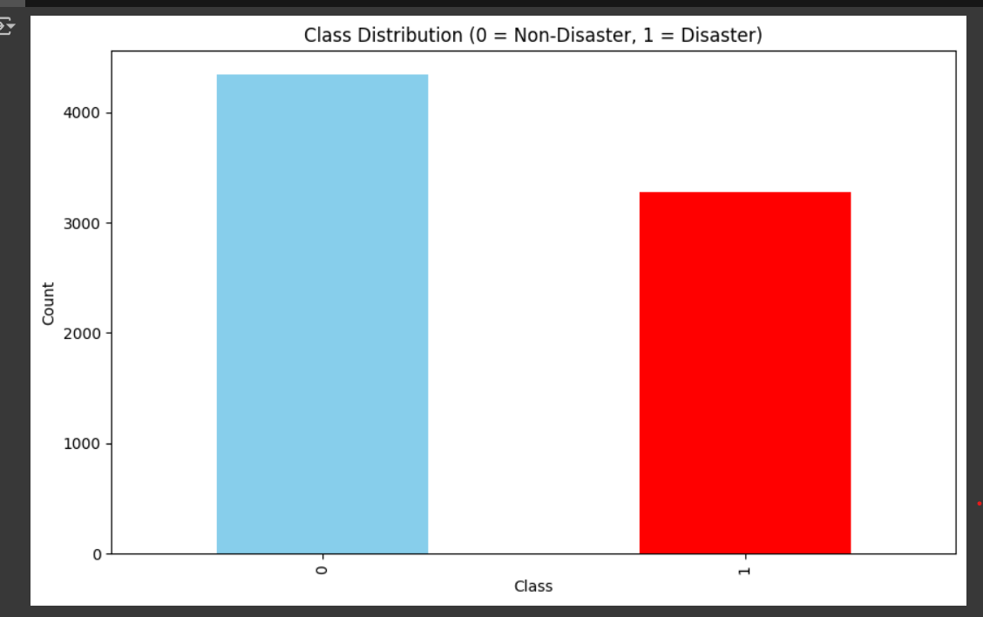

Slide 14
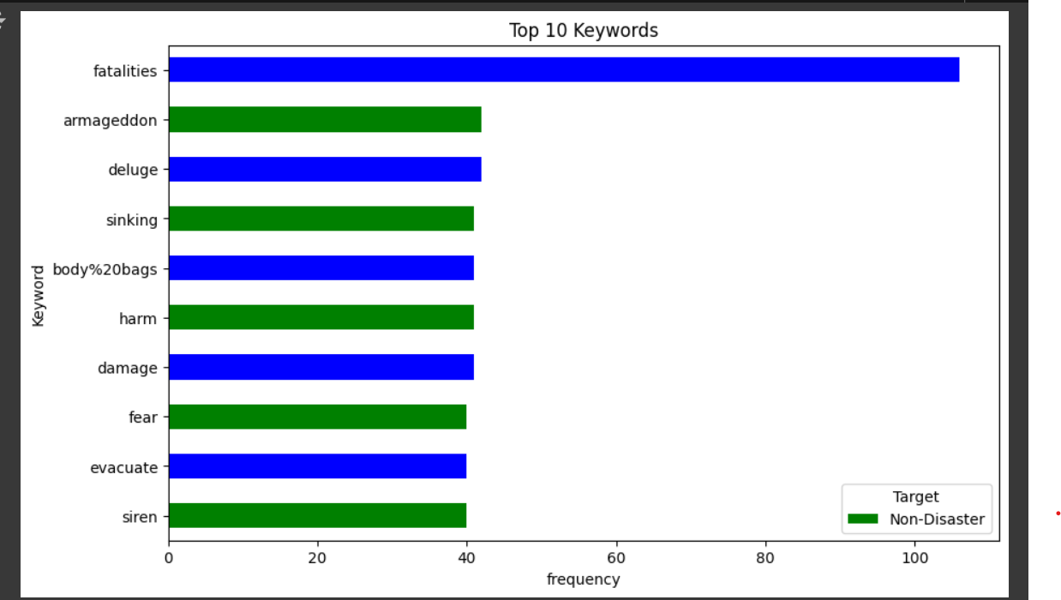
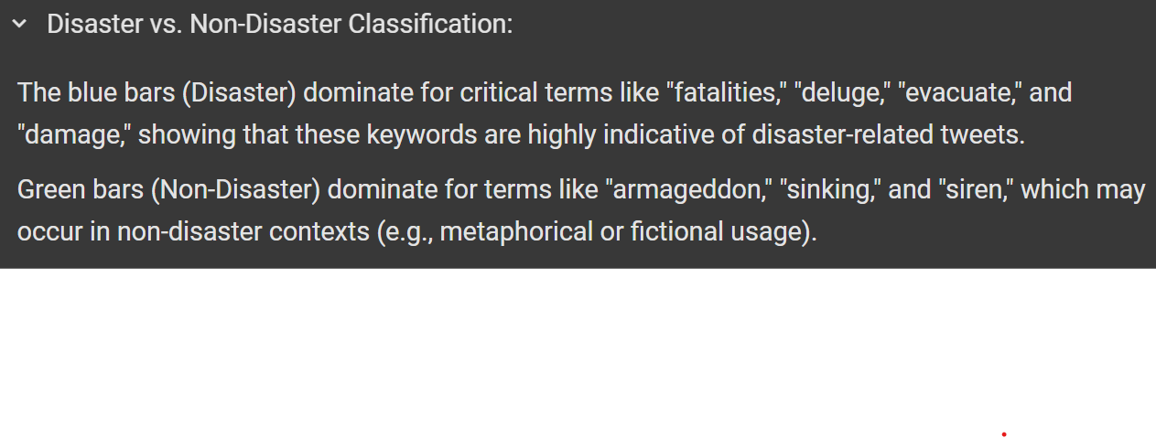

Slide 15
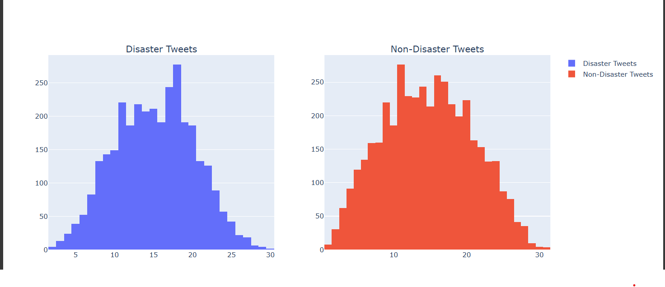
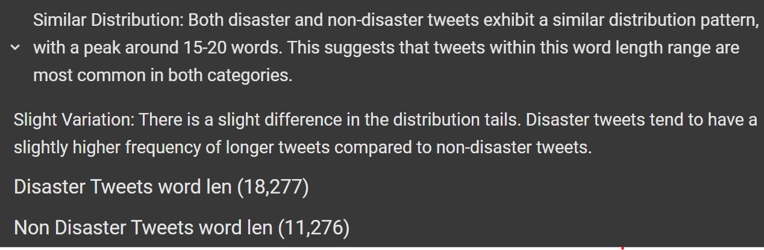

Slide 16
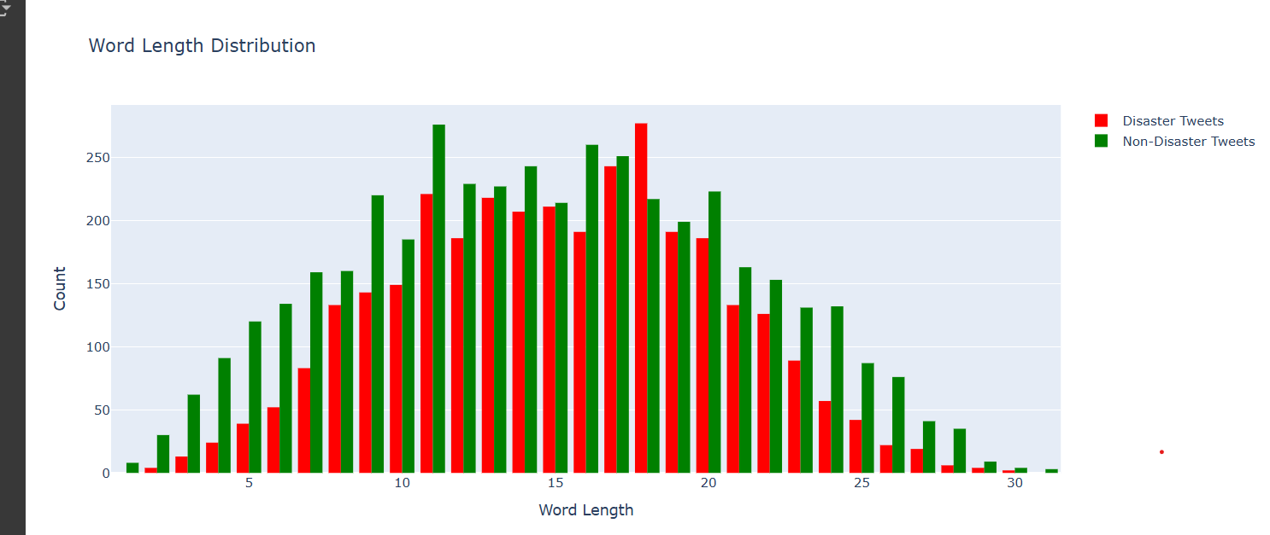
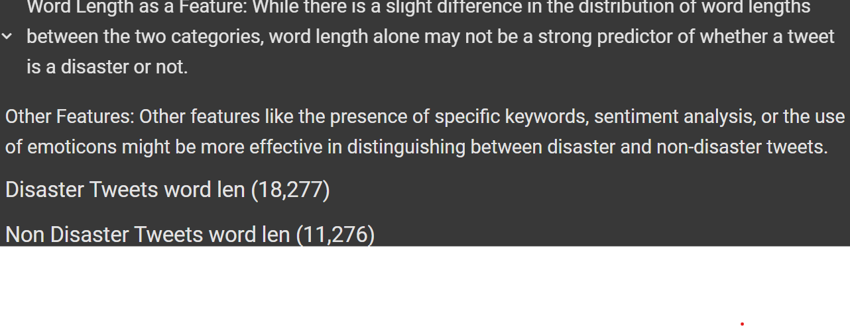

Slide 17
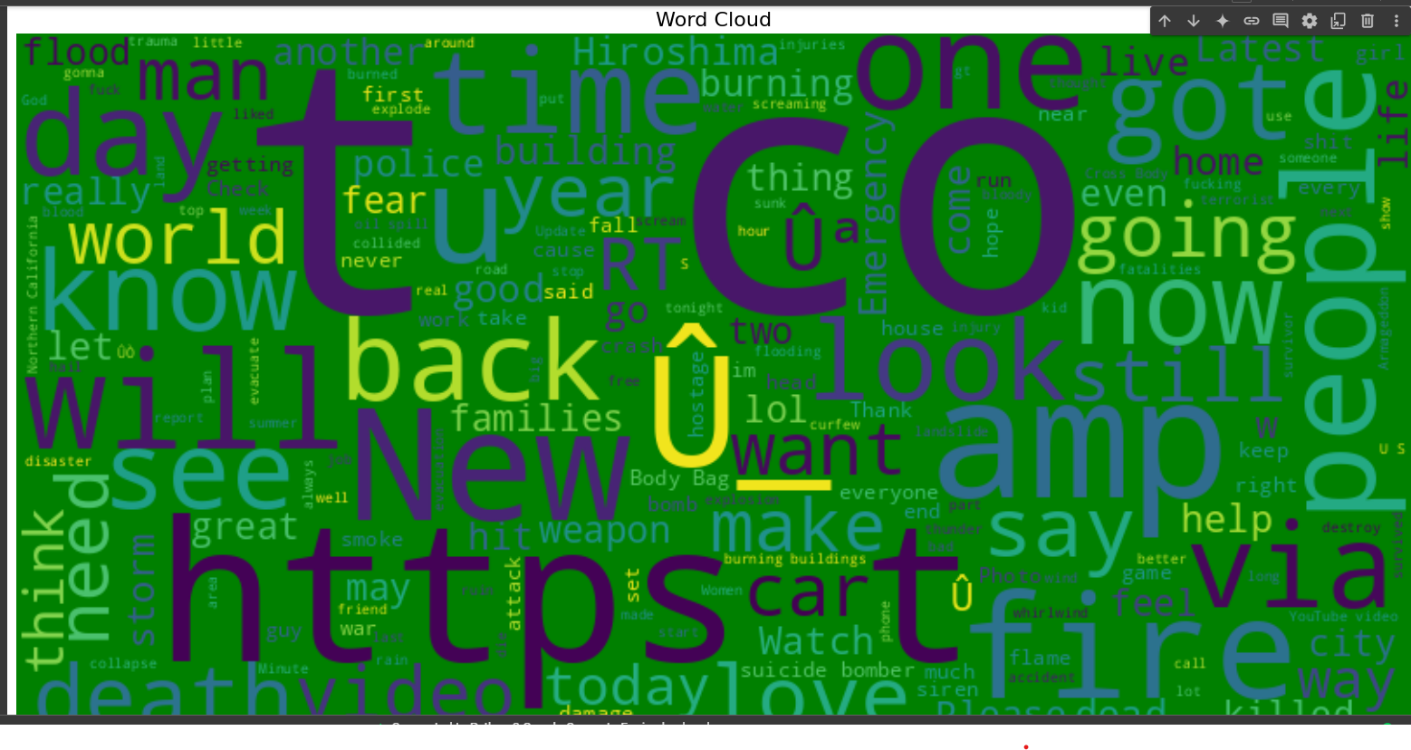
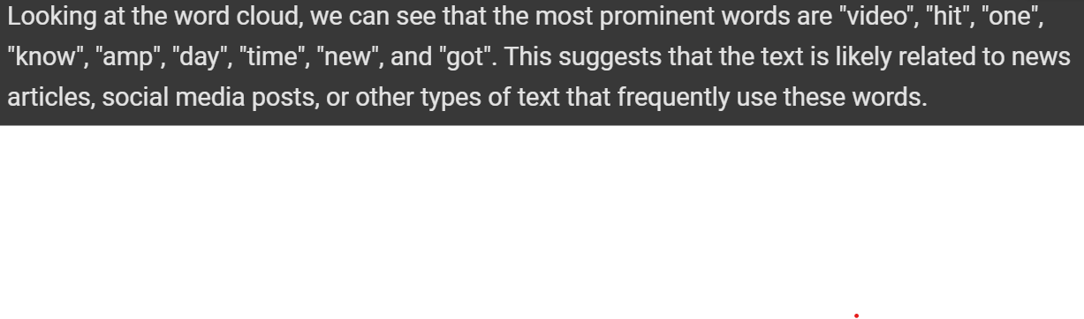

Slide 18
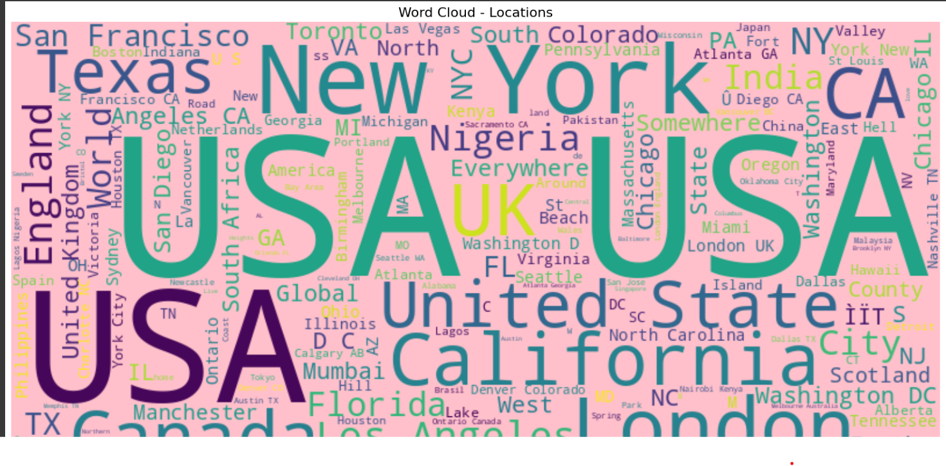
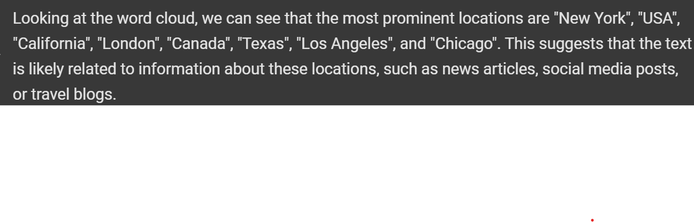

Slide 19
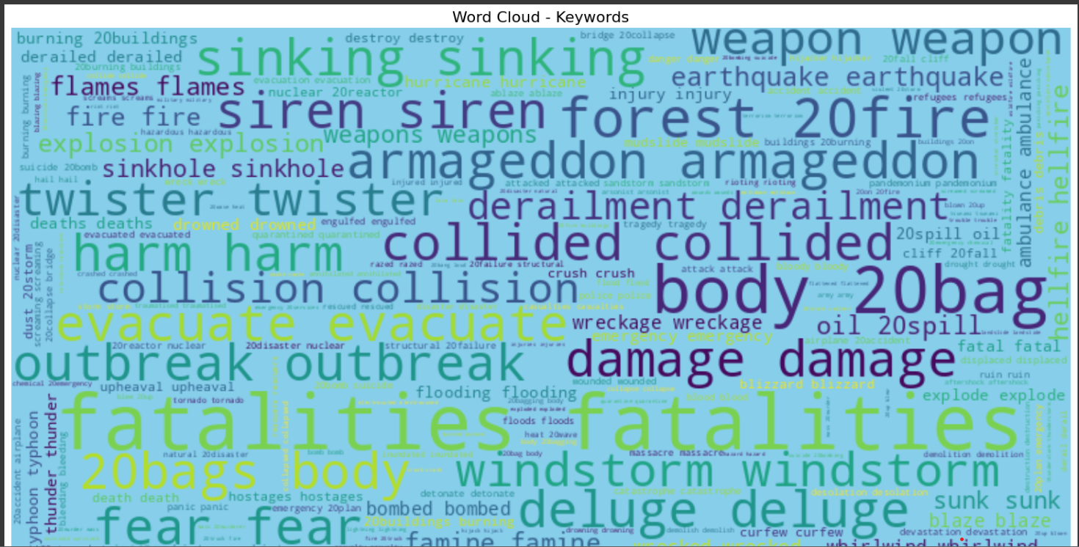
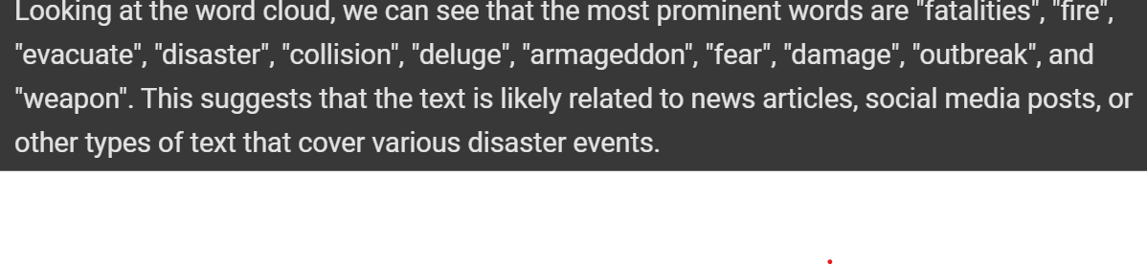

Slide 20
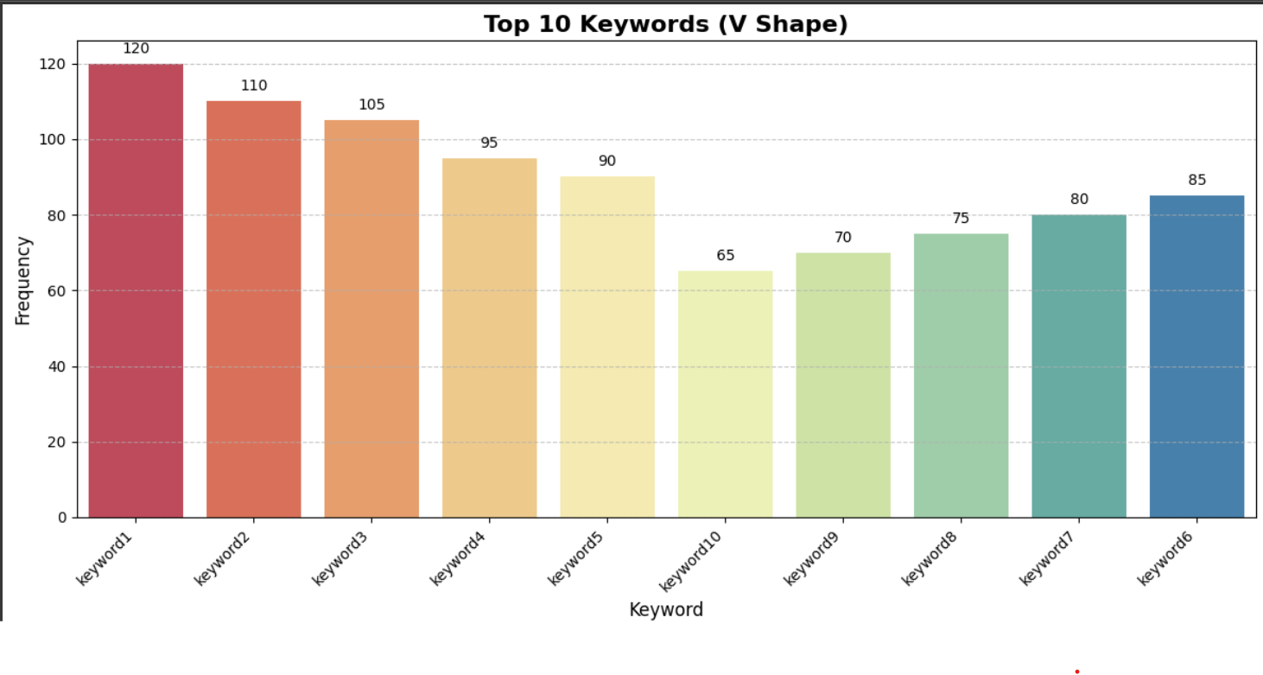
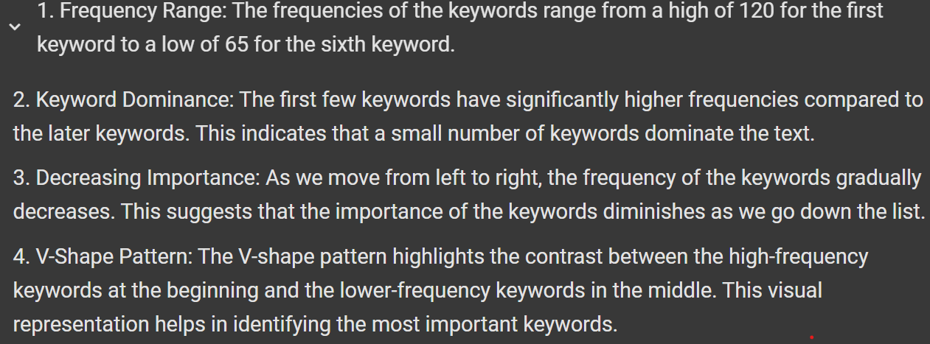

Slide 21
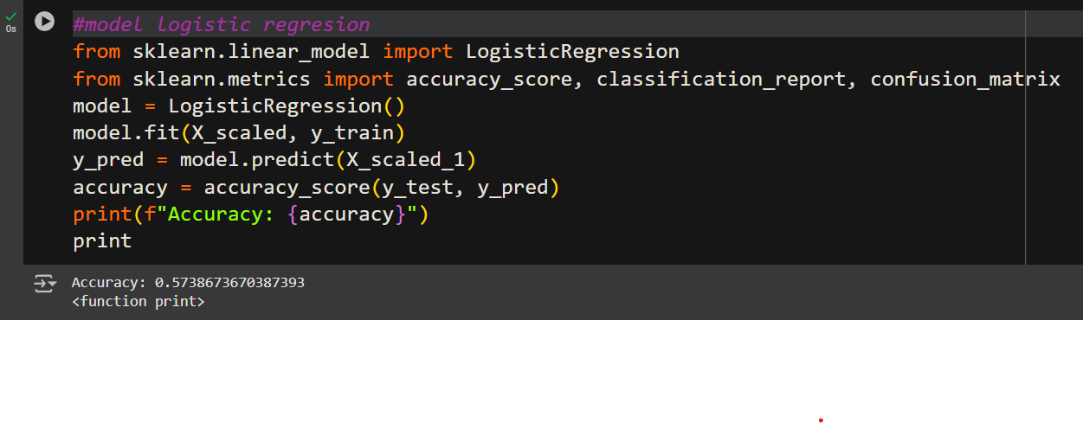
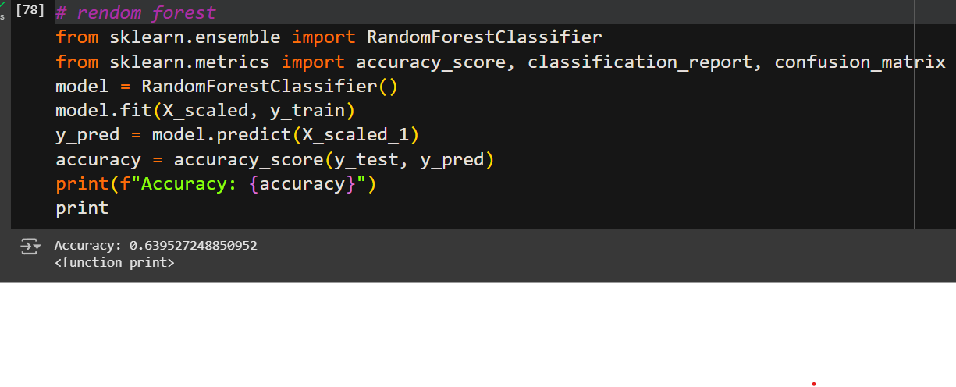

Slide 22
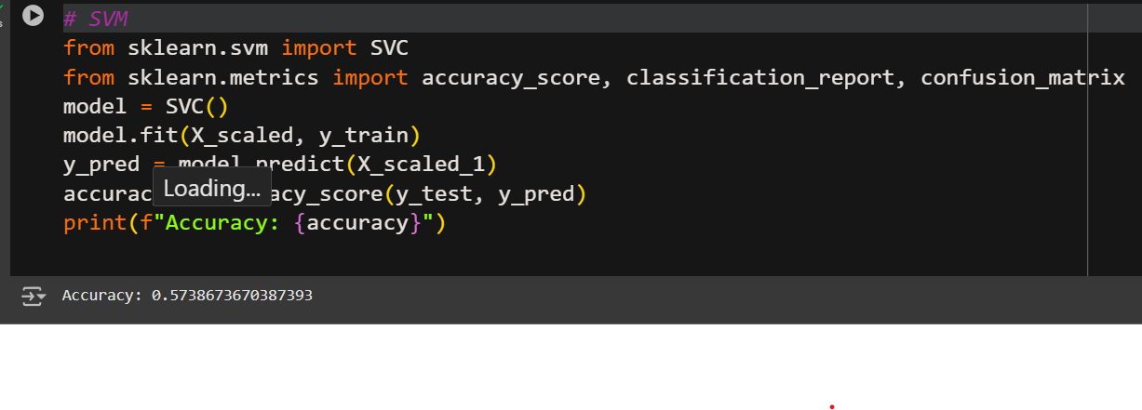
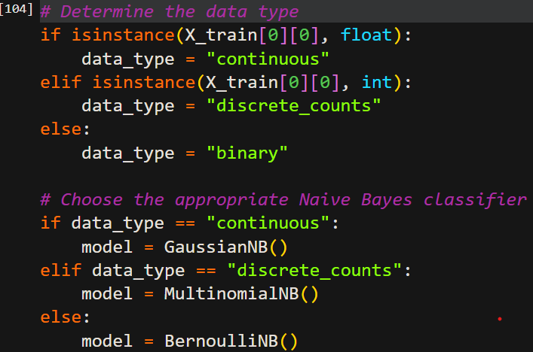
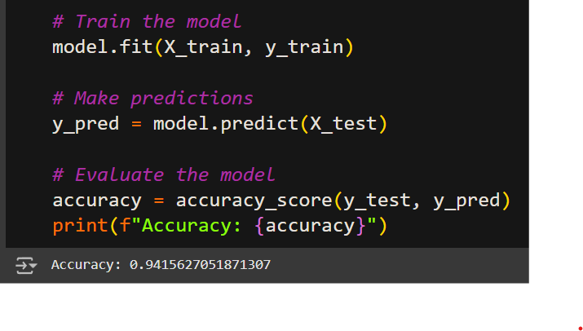

Slide 23
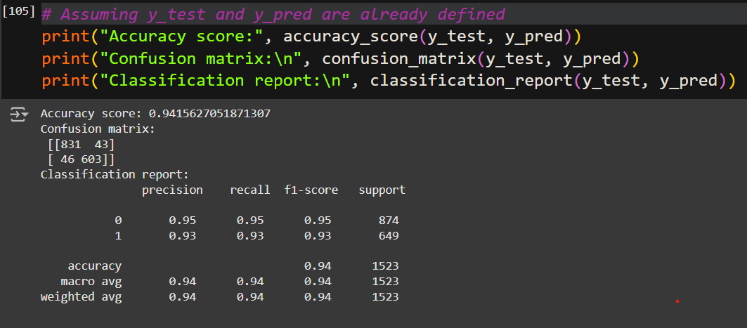
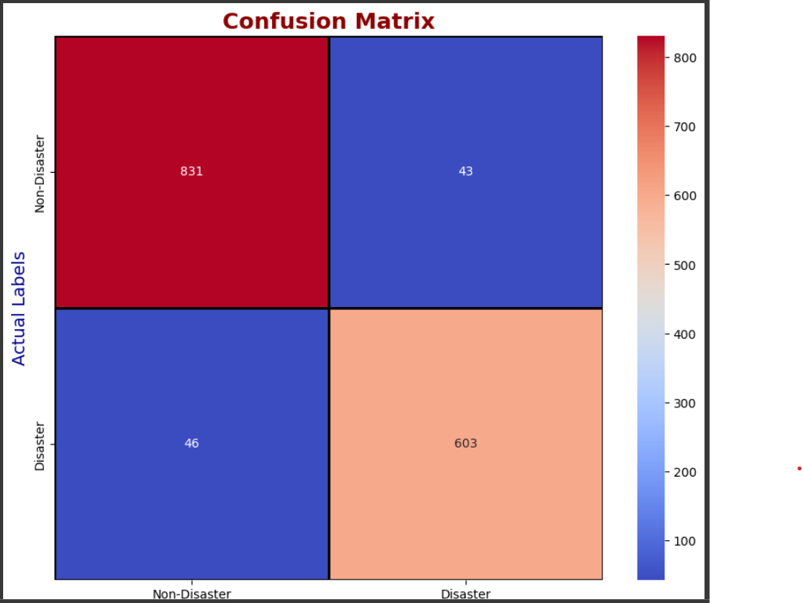

Slide 24
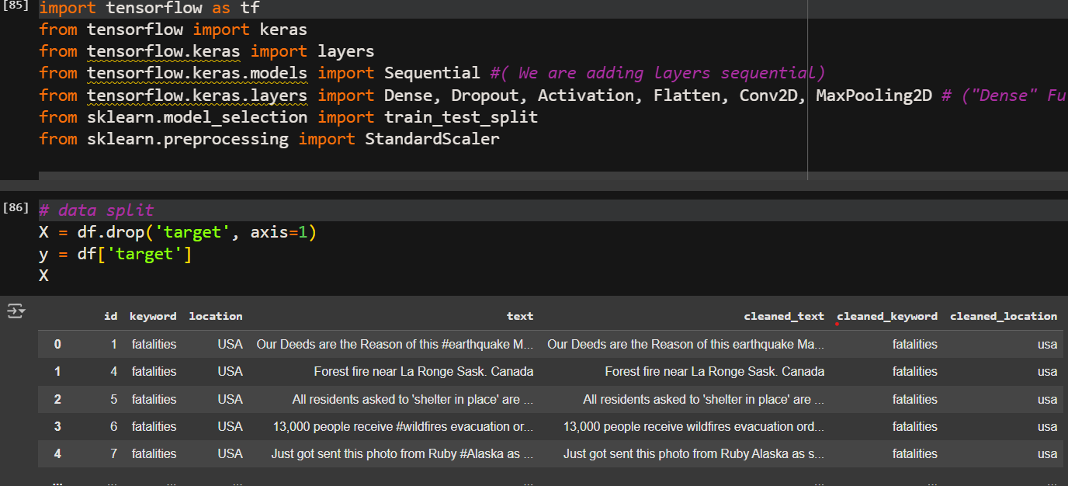

Slide 25
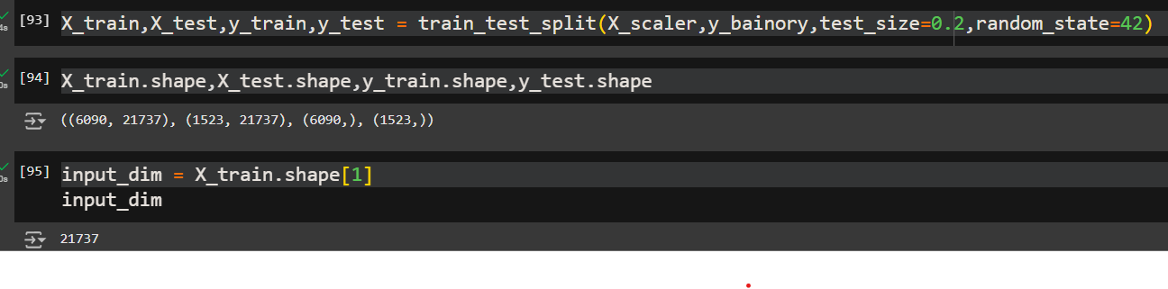
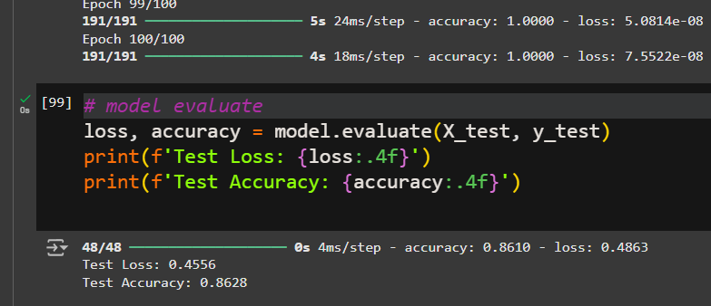
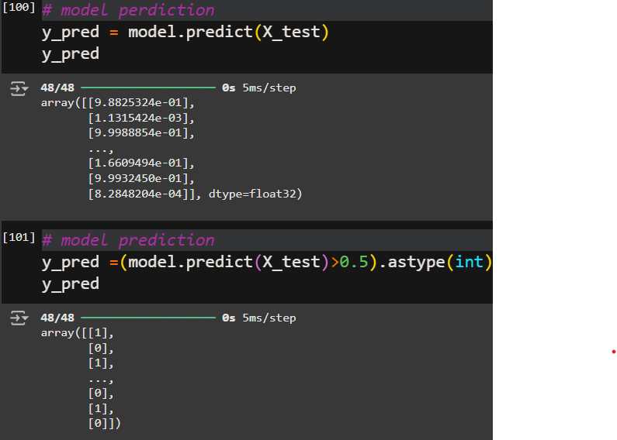

Slide 26
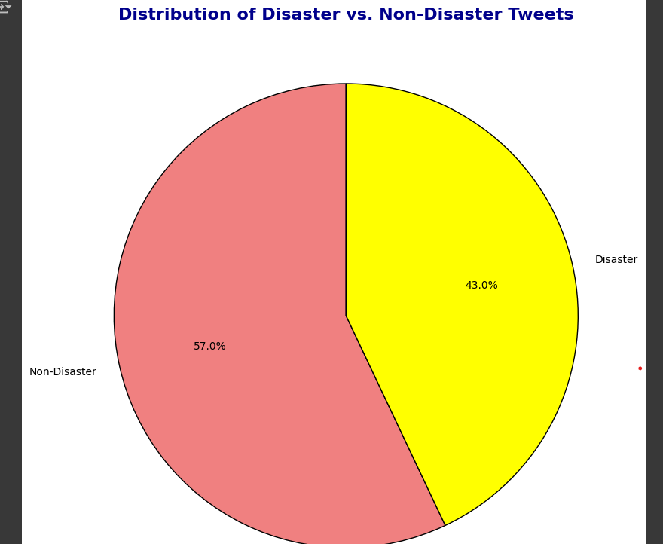
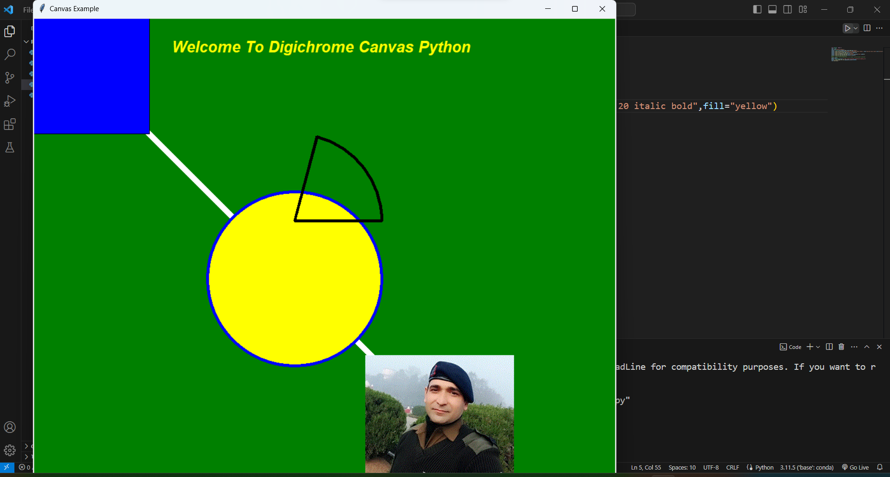
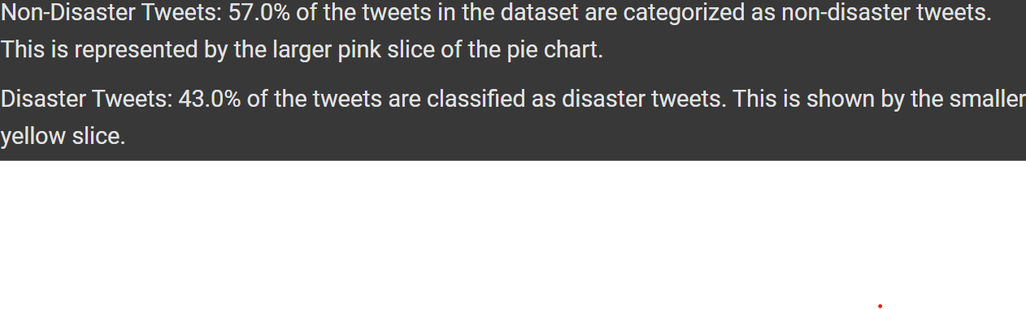
JAI HIND

